Slide 1


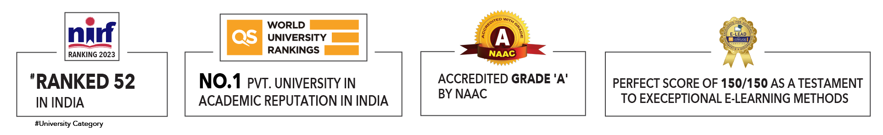

Slide 2

Unit 4 : Types of machine learning
Lecture 4: Unsupervised Learning: Clustering
Submitted by:
Dr. Kapil Gupta
School of Computer Science UPES, Dehradun
India

Slide 3
Table of Contents
Clustering
Types of Clustering Methods
Clustering Algorithms
Applications of Clustering

Slide 4
Learning & Course Outcomes
LO1: Identify and describe various clustering algorithms, including K-Means, Hierarchical Clustering, DBSCAN, and Gaussian Mixture Models
LO2: Implement clustering algorithms from scratch or using machine learning libraries such as scikit-learn
LO3:Assess the performance of clustering algorithms using metrics such as silhouette score, Davies-Bouldin index, and within-cluster.
LO4: Handle real-world data challenges such as missing values, noise, and high dimensionality when performing clustering.
LO5: Apply clustering techniques to real-world problems across various domains, such as customer segmentation, image segmentation, anomaly detection, and bioinformatics.
CO2: Understand the basics of Machine Learning and its types.

Slide 5
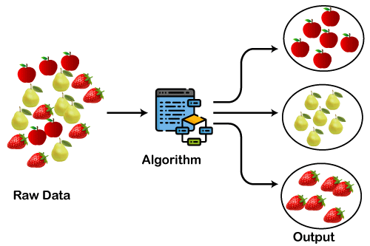
Clustering
A way of grouping the data points into different clusters, consisting of similar data points. The objects with the possible similarities remain in a group that has less or no similarities with another group.
Figure: 1

Slide 6
Clustering
It is an unsupervised learning method, hence no supervision is provided to the algorithm, and it deals with the unlabeled dataset.
After applying this clustering technique, each cluster or group is provided with a cluster-ID. ML system can use this id to simplify the processing of large and complex datasets.
The clustering methods are broadly divided into
Hard clustering (datapoint belongs to only one group) and
Soft Clustering (data points can belong to another group also).
There are also other various approaches of Clustering exist:
Types of Clustering Methods

Slide 7
Types of Clustering Methods
Partitioning Clustering
Density-Based Clustering
Distribution Model-Based Clustering
Hierarchical Clustering
Fuzzy Clustering

Slide 8
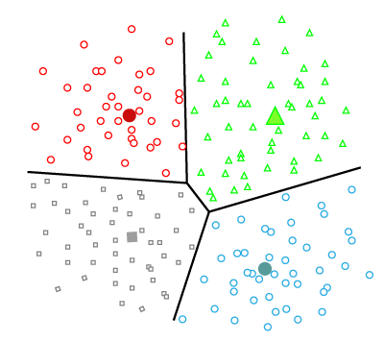
Types of Clustering Methods
Partitioning Clustering: It is a type of clustering that divides the data into non-hierarchical groups.
It is also known as the centroid-based method.
Figure: 2

Slide 9
Types of Clustering Methods
The most common example of partitioning clustering is the K-Means Clustering algorithm.
In this type, the dataset is divided into a set of k groups, where K is used to define the number of pre-defined groups.
The cluster center is created in such a way that the distance between the data points of one cluster is minimum as compared to another cluster centroid.
Density-Based Clustering: The density-based clustering method connects the highly-dense areas into clusters, and the arbitrarily shaped distributions are formed as long as the dense region can be connected.
This algorithm does it by identifying different clusters in the dataset and connects the areas of high densities into clusters.
The dense areas in data space are divided from each other by sparser areas.

Slide 10
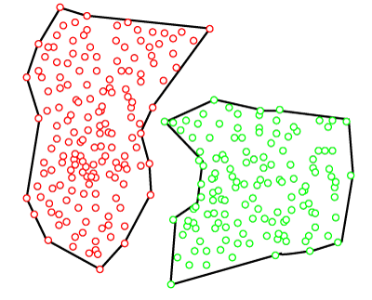
Types of Clustering Methods
These algorithms can face difficulty in clustering the data points if the dataset has varying densities and high dimensions.
Figure: 3

Slide 11
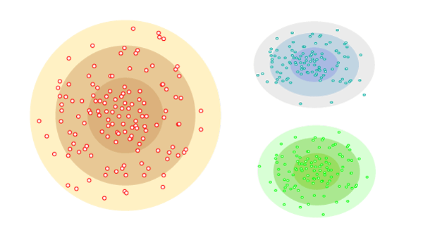
Types of Clustering Methods
Distribution Model-Based Clustering: In the distribution model-based clustering method, the data is divided based on the probability of how a dataset belongs to a particular distribution.
Figure: 4

Slide 12
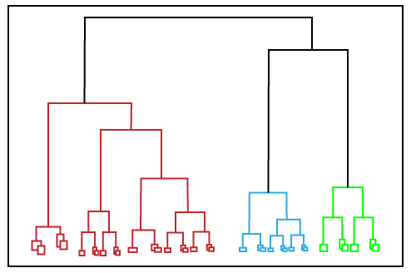
Types of Clustering Methods
The grouping is done by assuming some distributions commonly Gaussian Distribution.
The example of this type is the Expectation-Maximization Clustering algorithm that uses Gaussian Mixture Models (GMM).
Hierarchical Clustering: Hierarchical clustering can be used as an alternative for the partitioned clustering as there is no requirement of pre-specifying the number of clusters to be created. In this technique, the dataset is divided into clusters to create a tree-like structure, which is also called a dendrogram.
Figure: 5

Slide 13
Types of Clustering Methods
The observations or any number of clusters can be selected by cutting the tree at the correct level.
The most common example of this method is the Agglomerative Hierarchical algorithm.
Fuzzy Clustering: Fuzzy clustering is a type of soft method in which a data object may belong to more than one group or cluster.
Each dataset has a set of membership coefficients, which depend on the degree of membership to be in a cluster.
Fuzzy C-means algorithm is the example of this type of clustering; it is sometimes also known as the Fuzzy k-means algorithm.

Slide 14
Clustering Algorithms
Clustering Algorithms: The Clustering algorithms can be divided based on their models that are explained above.
The clustering algorithm is based on the kind of data that we are using.
Such as, some algorithms need to guess the number of clusters in the given dataset, whereas some are required to find the minimum distance between the observation of the dataset.
Some popular Clustering algorithms:
K-Means algorithm
Mean-shift algorithm
DBSCAN Algorithm
Expectation-Maximization Clustering using GMM
Agglomerative Hierarchical algorithm
Affinity Propagation

Slide 15
Clustering Algorithms
K-Means algorithm: The k-means algorithm is one of the most popular clustering algorithms.
It classifies the dataset by dividing the samples into different clusters of equal variances.
The number of clusters must be specified in this algorithm. It is fast with fewer computations required, with the linear complexity of O(n).
Mean-shift algorithm: Mean-shift algorithm tries to find the dense areas in the smooth density of data points.
It is an example of a centroid-based model, that works on updating the candidates for centroid to be the center of the points within a given region.
DBSCAN Algorithm: It stands for Density-Based Spatial Clustering of Applications with Noise. It is an example of a density-based model similar to the mean-shift, but with some remarkable advantages. In this algorithm, the areas of high density are separated by the areas of low density. Because of this, the clusters can be found in any arbitrary shape.

Slide 16
Clustering Algorithms
DBSCAN Algorithm: It stands for Density-Based Spatial Clustering of Applications with Noise.
It is an example of a density-based model similar to the mean-shift, but with some remarkable advantages.
In this algorithm, the areas of high density are separated by the areas of low density. Because of this, the clusters can be found in any arbitrary shape.
Expectation-Maximization Clustering using GMM: This algorithm can be used as an alternative for the k-means algorithm or for those cases where K-means can be failed.
In GMM, it is assumed that the data points are Gaussian distributed.
Agglomerative Hierarchical algorithm: The Agglomerative hierarchical algorithm performs the bottom-up hierarchical clustering.
In this, each data point is treated as a single cluster at the outset and then successively merged. The cluster hierarchy can be represented as a tree-structure.

Slide 17
Clustering Algorithms
Affinity Propagation: It is different from other clustering algorithms as it does not require to specify the number of clusters.
In this, each data point sends a message between the pair of data points until convergence.
It has O(N2T) time complexity, which is the main drawback of this algorithm.

Slide 18
Applications of Clustering
In Identification of Cancer Cells: The clustering algorithms are widely used for the identification of cancerous cells.
It divides the cancerous and non-cancerous data sets into different groups.
In Search Engines: Search engines also work on the clustering technique. The search result appears based on the closest object to the search query.
It does it by grouping similar data objects in one group that is far from the other dissimilar objects.
The accurate result of a query depends on the quality of the clustering algorithm used.
Customer Segmentation: It is used in market research to segment the customers based on their choice and preferences.

Slide 19
Applications of Clustering
In Biology: It is used in the biology stream to classify different species of plants and animals using the image recognition technique.
In Land Use: The clustering technique is used in identifying the area of similar lands use in the GIS database.
This can be very useful to find that for what purpose the particular land should be used, that means for which purpose it is more suitable.

Slide 20

Thank You

